Slide 1
Memory Management
Background
Swapping
Contiguous Allocation
Paging
Segmentation
Segmentation with Paging
Operating System Concepts

Slide 2
Background
Some important issues related to the need for memory management include:
Many times an operating system manages many processes (multi-programming).
The code and data for a process must be in RAM before it could be run.
Processes must not be able to access the code and data of other processes without permission. It means that the processes must be protected.
Processes must be able to access and share the code and data of other processes if they have permission.
There is usually not enough RAM to hold the code and data for all the currently running processes in RAM.
The Memory Management Module is the part of the operating system that must solve the above issues.
Operating System Concepts

Slide 3
Background
Program must be brought into memory and placed within a process for it to be run.
Input queue – collection of processes on the disk that are waiting to be brought into memory to run the program.
User programs go through several steps before being run.
Operating System Concepts

Slide 4
Binding of Instructions and Data to Memory
Address binding of instructions and data to memory addresses can
happen at three different stages.
Compile time: If memory location known a priori, absolute code can be generated; must recompile code if starting location changes.
Load time: Must generate relocatable code if memory location is not known at compile time.
Execution time: Binding delayed until run time if the process can be moved during its execution from one memory segment to another. Need hardware support for address maps (e.g., base and limit registers).
Operating System Concepts

Slide 5

Multistep Processing of a User Program
Operating System Concepts

Slide 6
Logical vs. Physical Address Space
The concept of a logical address space that is bound to a separate physical address space is central to proper memory management.
  Logical address – generated by the CPU; also referred to as virtual address.
  Physical address – address seen by the memory unit.
Logical and physical addresses are the same in compile-time and load-time address-binding schemes; logical (virtual) and physical addresses differ in execution-time address-binding scheme.
Operating System Concepts

Slide 7
Memory-Management Unit (MMU)
Hardware device that maps virtual to physical address.
In MMU scheme, the value in the relocation register is added to every address generated by a user process at the time it is sent to memory.
The user program deals with logical addresses; it never sees the real physical addresses.
Operating System Concepts

Slide 8

Dynamic relocation using a relocation register
Operating System Concepts

Slide 9
Dynamic Loading
Routine is not loaded until it is called
Better memory-space utilization; unused routine is never loaded.
Useful when large amounts of code are needed to handle infrequently occurring cases.
No special support from the operating system is required implemented through program design.
Operating System Concepts

Slide 10
Dynamic Linking
Linking postponed until execution time.
Small piece of code, stub, used to locate the appropriate memory-resident library routine.
Stub replaces itself with the address of the routine, and executes the routine.
Operating system needed to check if routine is in processes’ memory address.
Dynamic linking is particularly useful for libraries.
Operating System Concepts

Slide 11
Overlays
Keep in memory only those instructions and data that are needed at any given time.
Needed when process is larger than amount of memory allocated to it.
Implemented by user, no special support needed from operating system, programming design of overlay structure is complex
Operating System Concepts

Slide 12

Overlays for a Two-Pass Assembler
Operating System Concepts

Slide 13
Swapping
A process can be swapped temporarily out of memory to a backing store, and then brought back into memory for continued execution.
Backing store – fast disk large enough to accommodate copies of all memory images for all users; must provide direct access to these memory images.
Roll out, roll in – swapping variant used for priority-based scheduling algorithms; lower-priority process is swapped out so higher-priority process can be loaded and executed.
Major part of swap time is transfer time; total transfer time is directly proportional to the amount of memory swapped.
Modified versions of swapping are found on many systems, i.e., UNIX, Linux, and Windows.
Operating System Concepts

Slide 14

Schematic View of Swapping
Operating System Concepts

Slide 15
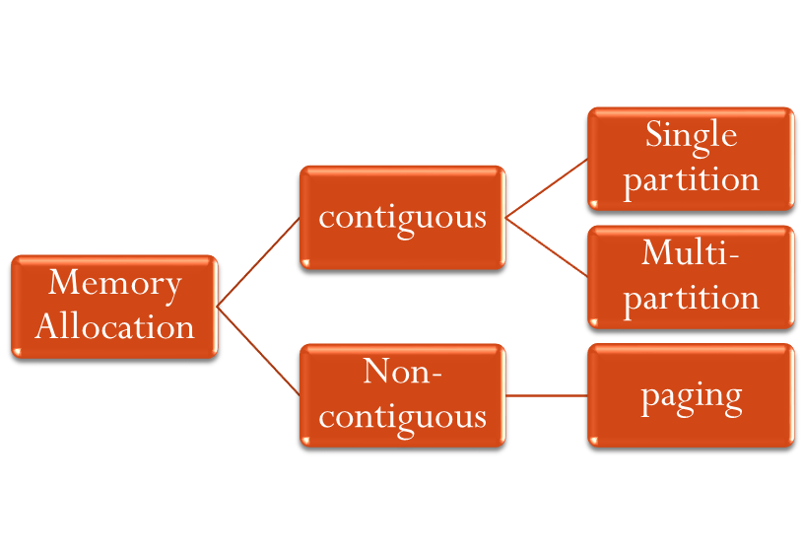
Memory Allocation Scheme
Fixed equal
Fixed Variable
Dynamic variable
Demand Paging
segmentation
Operating System Concepts

Slide 16
Contiguous Allocation
Main memory usually into two partitions:
  Resident operating system, usually held in low memory with interrupt vector.
  User processes then held in high memory.
Single-partition allocation
  Relocation-register scheme used to protect user processes from each other, and from changing operating-system code and data.
  Relocation register contains value of smallest physical address; limit register contains range of logical addresses – each logical address must be less than the limit register.
Operating System Concepts

Slide 17

Hardware Support for Relocation and Limit Registers
Operating System Concepts

Slide 18
Contiguous Allocation (Cont.)
Multiple-partition allocation
  Hole – block of available memory; holes of various size are scattered throughout memory.
  When a process arrives, it is allocated memory from a hole large enough to accommodate it.
  Operating system maintains information about:
  a) allocated partitions b) free partitions (hole)
OS
OS
OS
OS
process 5
process 5
process 5
process 5
process 9
process 9
process 8
process 10
process 2
process 2
process 2
process 2
Operating System Concepts

Slide 19
Allocation Problem
JOB QUEUE
PARTITIONS
JOB | SIZE | AT
J1 | 825KB | 10MS
J2 | 600KB | 5
J3 | 1200KB | 20
J4 | 500KB | 30
J5 | 650KB | 15
PARTION | SIZE
P1 | 700KB
P2 | 400KB
P3 | 525KB
P4 | 900KB
P5 | 350KB
P6 | 625KB
MAIN MEMORY SIZE -4000KB
OPERATING SYSTEM OCCUPIES-500KB
Operating System Concepts

Slide 20
Dynamic Storage-Allocation Problem
How to satisfy a request of size n from a list of free holes.
First-fit: Allocate the first hole that is big enough.
Best-fit: Allocate the smallest hole that is big enough; must search entire list, unless ordered by size. Produces the smallest leftover hole.
Worst-fit: Allocate the largest hole; must also search entire list. Produces the largest leftover hole.
First-fit and best-fit better than worst-fit in terms of speed and storage utilization.
Operating System Concepts

Slide 21
Fragmentation
External Fragmentation – total memory space exists to satisfy a request, but it is not contiguous.
Internal Fragmentation – allocated memory may be slightly larger than requested memory; this size difference is memory internal to a partition, but not being used.
Reduce external fragmentation by compaction
  Shuffle memory contents to place all free memory together in one large block.
  Compaction is possible only if relocation is dynamic, and is done at execution time.
  I/O problem
    Latch job in memory while it is involved in I/O.
    Do I/O only into OS buffers.
Operating System Concepts

Slide 22
Paging
Logical address space of a process can be noncontiguous; process is allocated physical memory whenever the latter is available.
Divide physical memory into fixed-sized blocks called frames (size is power of 2, between 512 bytes and 8192 bytes).
Divide logical memory into blocks of same size called pages.
Keep track of all free frames.
To run a program of size n pages, need to find n free frames and load program.
Set up a page table to translate logical to physical addresses.
Internal fragmentation.
Operating System Concepts

Slide 23
Address Translation Scheme
Address generated by CPU is divided into:
  Page number (p) – used as an index into a page table which contains base address of each page in physical memory.
  Page offset (d) – combined with base address to define the physical memory address that is sent to the memory unit.
Operating System Concepts

Slide 24

Address Translation Architecture
Operating System Concepts

Slide 25

Paging Example
Operating System Concepts

Slide 26

Paging Example
Operating System Concepts

Slide 27
Implementation of Page Table
Page table is kept in main memory.
Page-table base register (PTBR) points to the page table.
Page-table length register (PRLR) indicates size of the page table.
In this scheme every data/instruction access requires two memory accesses. One for the page table and one for the data/instruction.
The two memory access problem can be solved by the use of a special fast-lookup hardware cache called associative memory or translation look-aside buffers (TLBs)
Operating System Concepts

Slide 28
Associative Memory
Associative memory – parallel search
Address translation (A´, A´´)
  If A´ is in associative register, get frame # out.
  Otherwise get frame # from page table in memory
Page #
Frame #
Operating System Concepts

Slide 29

Paging Hardware With TLB
Operating System Concepts

Slide 30
Memory Protection
Memory protection implemented by associating protection bit with each frame.
Valid-invalid bit attached to each entry in the page table:
  “valid” indicates that the associated page is in the process’ logical address space, and is thus a legal page.
  “invalid” indicates that the page is not in the process’ logical address space.
Operating System Concepts

Slide 31

Valid (v) or Invalid (i) Bit In A Page Table
Operating System Concepts

Slide 32
Shared Pages
Shared code
  One copy of read-only (reentrant) code shared among processes (i.e., text editors, compilers, window systems).
  Shared code must appear in same location in the logical address space of all processes.
Private code and data
  Each process keeps a separate copy of the code and data.
  The pages for the private code and data can appear anywhere in the logical address space.
Operating System Concepts

Slide 33

Shared Pages Example
Operating System Concepts

Slide 34
Segmentation
Memory-management scheme that supports user view of memory.
A program is a collection of segments. A segment is a logical unit such as:
main program,
procedure,
function,
method,
object,
local variables, global variables,
common block,
stack,
symbol table, arrays
Operating System Concepts

Slide 35

User’s View of a Program
Operating System Concepts

Slide 36
Logical View of Segmentation
1
1
4
2
3
4
2
3
user space
physical memory space
Operating System Concepts

Slide 37
Segmentation Architecture
Logical address consists of a two tuple:
<segment-number, offset>,
Segment table – maps two-dimensional physical addresses; each table entry has:
  base – contains the starting physical address where the segments reside in memory.
  limit – specifies the length of the segment.
Segment-table base register (STBR) points to the segment table’s location in memory.
Segment-table length register (STLR) indicates number of segments used by a program;
segment number s is legal if s < STLR.
Operating System Concepts

Slide 38
Segmentation Architecture (Cont.)
Relocation.
  dynamic
  by segment table
Sharing.
  shared segments
  same segment number
Allocation.
  first fit/best fit
  external fragmentation
Operating System Concepts

Slide 39
Segmentation Architecture (Cont.)
Protection. With each entry in segment table associate:
  validation bit = 0 ⇒ illegal segment
  read/write/execute privileges
Protection bits associated with segments; code sharing occurs at segment level.
Since segments vary in length, memory allocation is a dynamic storage-allocation problem.
A segmentation example is shown in the following diagram
Operating System Concepts

Slide 40

Segmentation Hardware
Operating System Concepts

Slide 41

Example of Segmentation
Operating System Concepts

